Slide 1
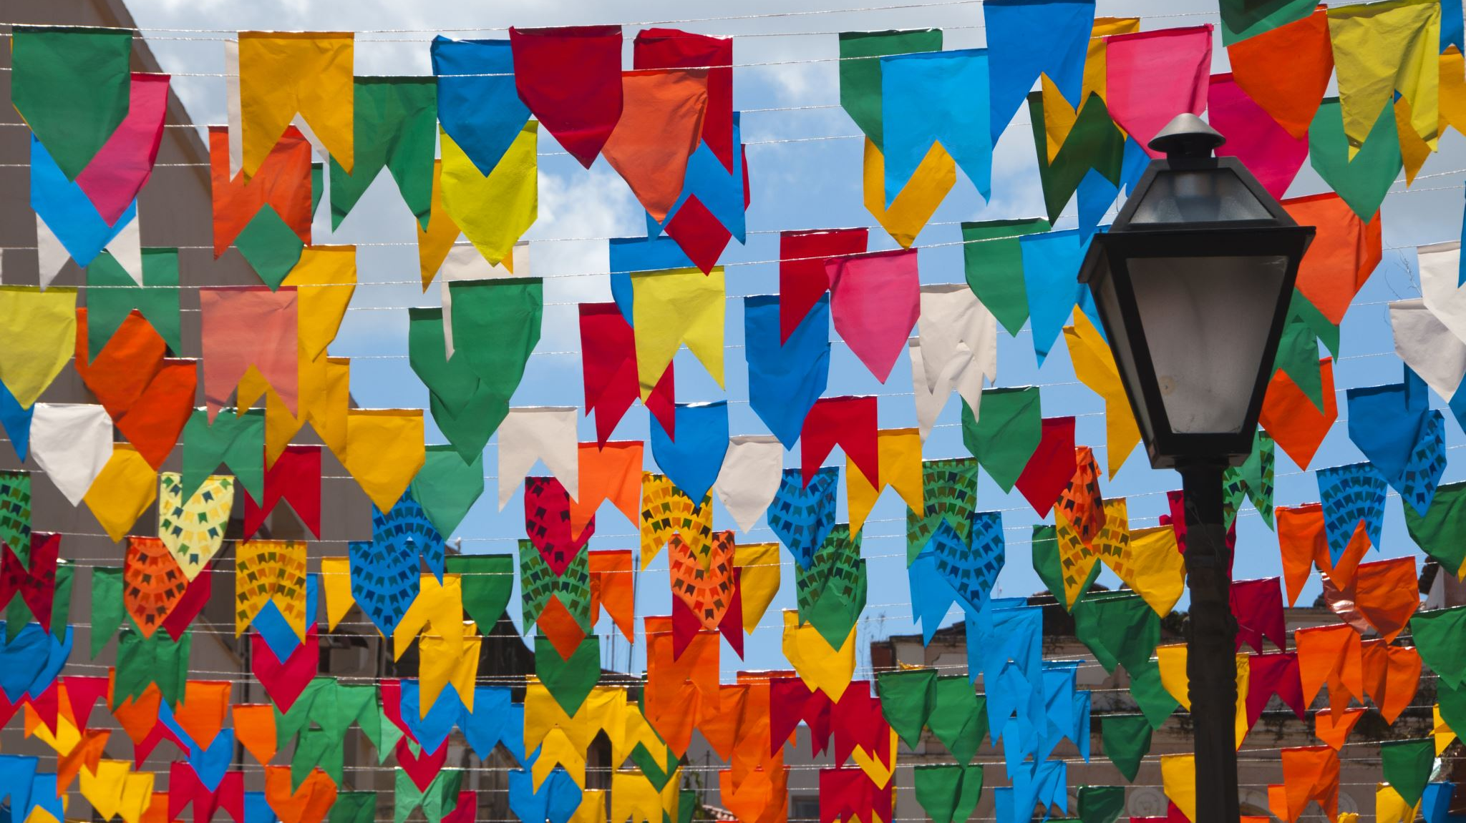
Heritage Fiesta April 23, 2022
Interview with Jim Brasile

Slide 2
The Setting: CCSU campus
Jim Brasile, 71, was born on September 11th, 1950, in New Britain, CT, and lived there all his life, except for 6 years when he lived in Farmington. He is married with 2 adult children and 5 grandkids. His father was born in Italy, and his mother was mixed Belgian, Spanish, French, and German. His son is an assistant principal at New Britain High School.
From left, Jocelyn, Nate, Sammy, and Jim Brasile

Slide 3
Growing up in New Britain, Jim identifies with the New Britain Italian community. His mother learned Italian cooking. He and his family, which included a brother and sister, attended the Italian church in New Britain. Jim remembers camping with his family at Rocky Neck in the 50’s. He joined the Marines at 17, around 1968, and served in Vietnam during the war for about two years. When he got back, he worked at Fafnir Ball Bearing factory on Myrtle Street as an inspector. After that he went to Hartford State Tech and earned an associates degree in electrical engineering. He then worked as a technician at Hartford Hospital and Corometrics Medical Systems for about 10 years. His wife got him interested in Little League baseball, and he ended up coaching for the Police Athletic League team. He discovered that he enjoyed working with kids and decided to go back to school and get a teaching degree. Jim attended Central Connecticut State University on the G.I. bill, and taught for twenty-five years, off-and-on, in the Hartford archdiocese. After he retired, he worked in real estate, and now he helps his wife with the grandkids. His wife went to CCSU as well, when the tuition was $90 per semester. Her father complained that he had to pay $50 for her books!

Slide 4
VIETNAM
“I was at New Britain High School. I signed up for the Marines at seventeen. I went to Paris Island, South Carolina, at eighteen. They told me to go to Vietnam at nineteen and I was home before I was twenty. So, It’s not quite two years that I spent in the military. I was at Chu Lai (in) Vietnam. That was a Marine Corps airbase. And I always educate people on the fact that over fifty-eight thousand people were -um, Americans- were killed in Vietnam, they had the Vietnam War (memorial wall) down in Washington D.C. And, uh, I always ask some of the kids, I say, “Do you know how many Southeast Asians were killed during that time?” Do you?”
NATE: ” A couple million?”
JIM: “3.5 million Southeast Asians.”
Jim at 18, Vietnam
“A Marine is a rifleman first”

Slide 5
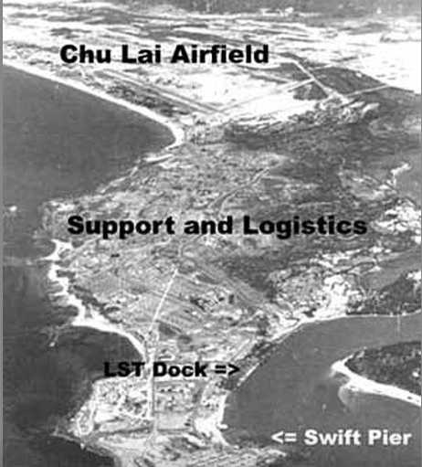
Chu Lai
Chu Lai was a United States Marine Corps military base from 1965 to 1970, and a United States Army military base from 1970 to 1971 during the Vietnam war. Roughly 56 miles (90 km) southeast of the major base at Đà Nẵng, Chu Lai had an airfield to supplement Đà Nẵng.

Slide 6
Life on the Base
“…this happens to be my friend Rick Kowalczyk who grew up in New Britain, also. He was my best friend… He enlisted in the army… (and) was a Ranger. He was in a lot more action than I was. And on Christmas Day, in nineteen- that would be- seventy, he showed up in what they called “the hooch” in those days… and walked in the door.”

Slide 7
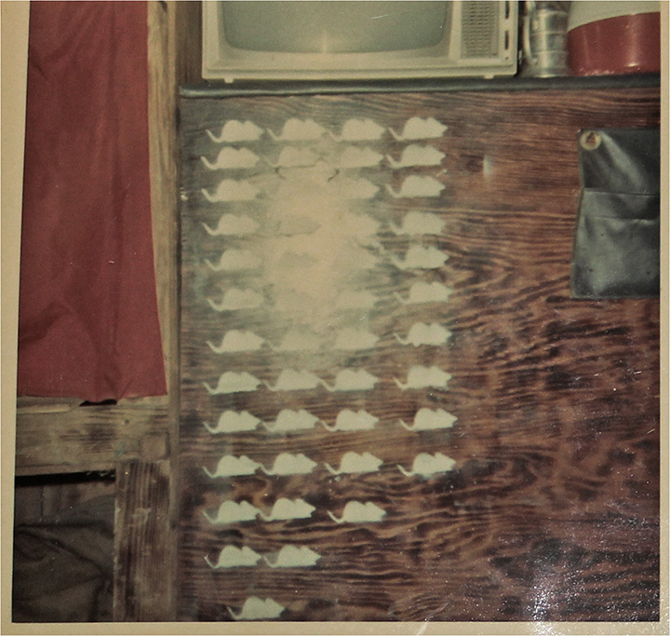
The Hooch
“(This is) where we bunked… and the rats we had to kill…”

Slide 8
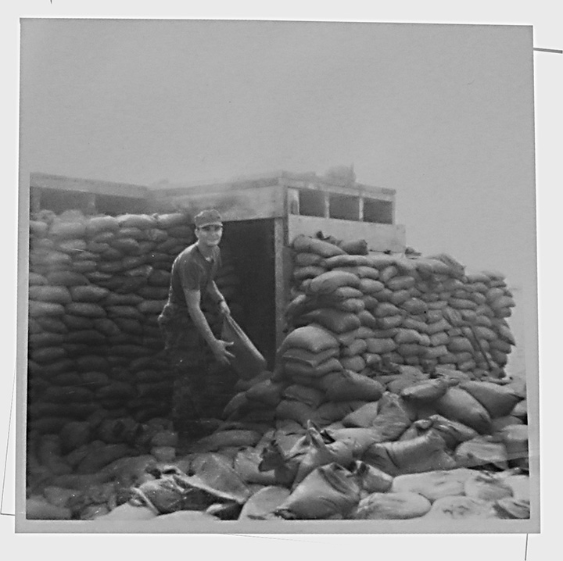
Jim’s bunk and rifle in the hooch
Jim on sandbag detail. Jim’s “m.o.s.” was supply specialist.

Slide 9
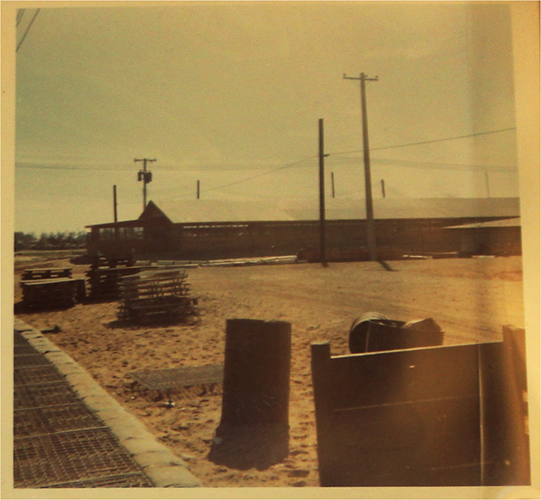
“You know, I was lucky that I was not in that mountain in the background…”
Another view of the base at Chu Lai

Slide 10
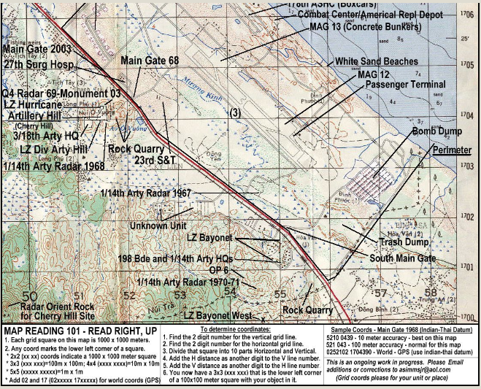
Another view of the base at Chu Lai showing the hooches
Topographical map of the base at Chu Lai

Slide 11
Veterans for Peace
How did Jim find out about the Heritage Fiesta? “Our group, Veterans For Peace, did a presentation at the New Britain Public Library on a book called “Un-American” and it was about a veteran’s experience in Afghanistan and how it was, it’s un-American to go to war, at this point, in our, you know, human development. So, we did a presentation and Juan (Coronado) showed up. And actually, I saw him at a church, St. Mary’s, because he’s done interviews over there, at St. Mary’s Church in New Britain. So he got up and said something. I introduced myself and I told him about the presentation at the library, and that he showed up, and that’s how we developed a relationship.”

Slide 12
Closing Remarks
NATE: “If there’s anything you’d like to close with…?”
JIM: This, like I said at the beginning, is an opportunity to open up communications with kids… it’s either football or basketball…they’re very involved in that, which is fine. But I think our country has come to the point, even the world, where we have to communicate a little bit more. Which I haven’t been. Like I said, I woke up at fifty and realized what was going on. Our country is in some situations here. We need your generation to step up and Veterans For Peace is here to give you a non-violent way of doing it. So we would like to, maybe, present with the professor, continue this conversation in some way. Yeah.
NATE: Alright. Thank-you.

